Slide 1
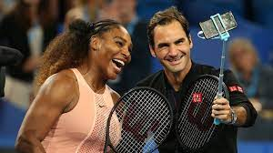
CS 677 Project
Tennis Analysis :
Winner Predictor
Submitted By :
Tushar Srivastava

Slide 2
Dataset Preparation
Data source :
https://github.com/serve:and:volley/atp:world:tour:tennis:data/tree/master/csv
Two types of data files : match scores and match stats.
Created a Python script to fetch data from github and merge the match scores and match stats data based on match ID to generate raw data for years 2015 to 2019.

Slide 3
Data Preprocessing
Raw data consisted of 94 columns and around 4000 rows of data for each year.
Removed Unused columns and created new columns based on some mathematical relation between numerical features. Eg : replaced col1 : total first serves and col2: total first serve in, with %of total serves in (col2/col1) for some of the features.
Created a Python script to generate winner data and loser data for each year with final usable columns for data analysis.
Merged the winner loser data for each year and now the final dataset consists of 5 years data

Slide 4
Final Dataset
Shape of data : (19969, 35)
Player1
player1_name
player1_serve_rating
player1_return_rating
player1_aces
player1_double_faults
player1_first_serve_percent
player1_win%_on_first_serve
player1_win%_on_second_serve
player1_break_points_faced
player1_break_points_converted
player1_tiebreaks_won
player1_return_points_won
player1_total_points_won
player1_games_won
player1_service_points_won
player1_service_games_won
Player2
player2_name
player2_serve_rating
player2_return_rating
player2_aces
player2_double_faults
player2_first_serve_percent
player2_win%_on_first_serve
player2_win%_on_second_serve
player2_break_points_faced
player2_break_points_converted
player2_tiebreaks_won
player2_return_points_won
player2_total_points_won
player2_games_won
player2_service_points_won
player2_service_games_won
winner

Slide 5
Machine Learning Models
Ran some ML Classifiers to find the model that gives best accuracy.
Below are the accuracy percentages of various models I used :
Models that require Scaling
KNN (best N=13) : 97.58
Linear SVM : 98.73
Gaussian SVM : 98.61
Polynomial SVM (deg=2) : 93.72
Linear Discriminant Analysis : 98.75
Quadratic Discriminant Analysis : 96.46
Models without Scaling
Logistic Regression : 98.81
Gaussian Naive Bayes : 96.68
Decision tree : 97.76
Random Forest (n=30) : 98.05

Slide 6
Best Model : Logistic Regression
Created a Logistic Regression Model (model.pkl) using Pickle package.
Wrote a python script for predicting each feature stats of a player using linear model.
Decided to go with average stats for a player because excluding the top 10:15 players, the stats of rest of the players are not consistent hence difficult to predict.
Used the model.pkl file in my basic Flask application to take user input and predict the winner using the Logistic model.

Slide 7
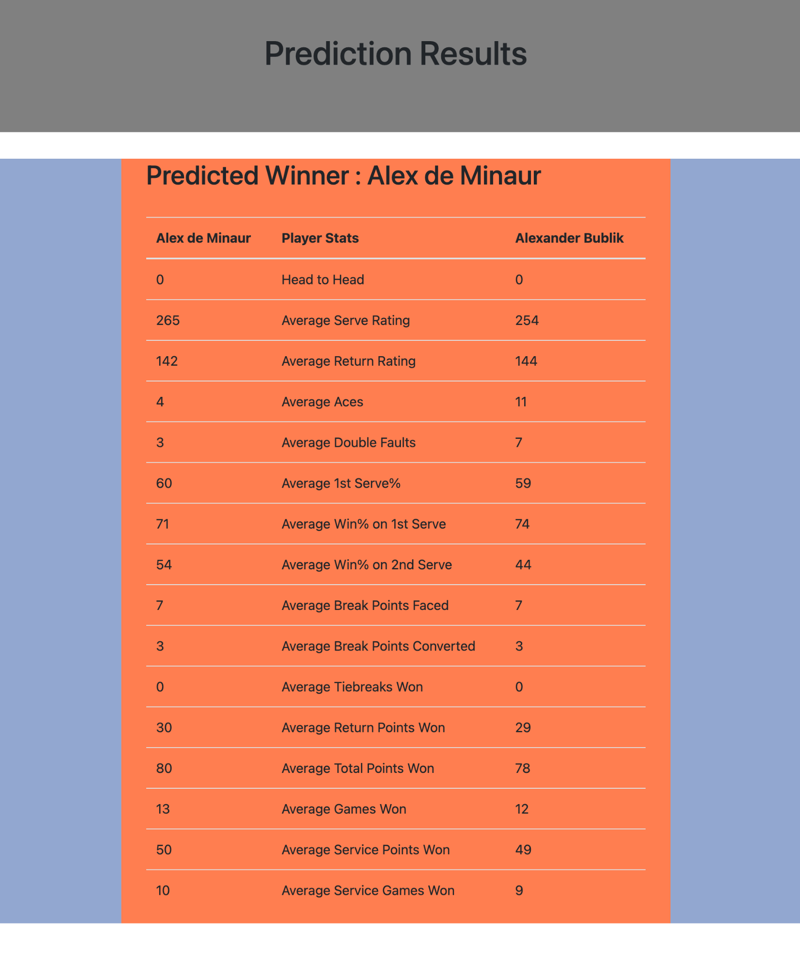
Sample Prediction Result using Flask application
Blog : Break Points is a major factor in determining the winner

Slide 8
Future Scope
To find Unforced Error data and use it in the model because it is also an important factor in predicting the winner.
Data analysis of a player’s game features to see the trend of a player’s performance.
Analysis of Grand Slams.

Slide 9
Demo
Thank You!

